Slide 1
Performance testing
Dang thi thao my

Slide 2
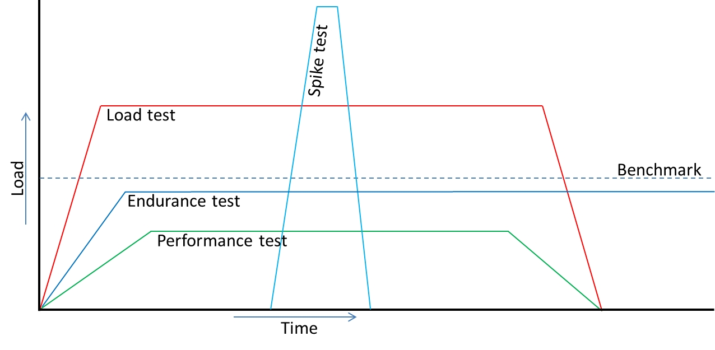
Types of performance testing

Slide 3
Types of performance testing
Classic performance testing – response times and transaction rates
Load testing – test ability to handle varied workloads, conducted with anticipated loads.
Stress testing – competition for resources
Volume/Spike testing – large amount of data to determine the point of failure
Endurance/Soak testing – Long period of time

Slide 4
Execute the scenario at least three cycles
Baseline Test
Perform the test with 15-20% of target load
Load Test
Perform with actual load for three cycles
Steady state duration: min. 1hr
Stress Test
Perform load test and then slowly ram-up the load step-by-step. Disable Think time and Cache settings.
Steady state duration: min. 2-3 hrs
Endurance Test
Perform load test for 10-14 hours to identify memory leak

Slide 5
Metrics
Response time
Throughput
Transactions per second
CPU Usage
Memory
Disk utilization

Slide 6
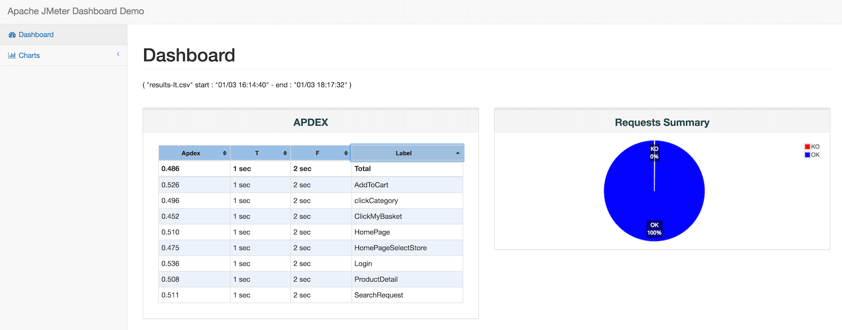
Report

Slide 7
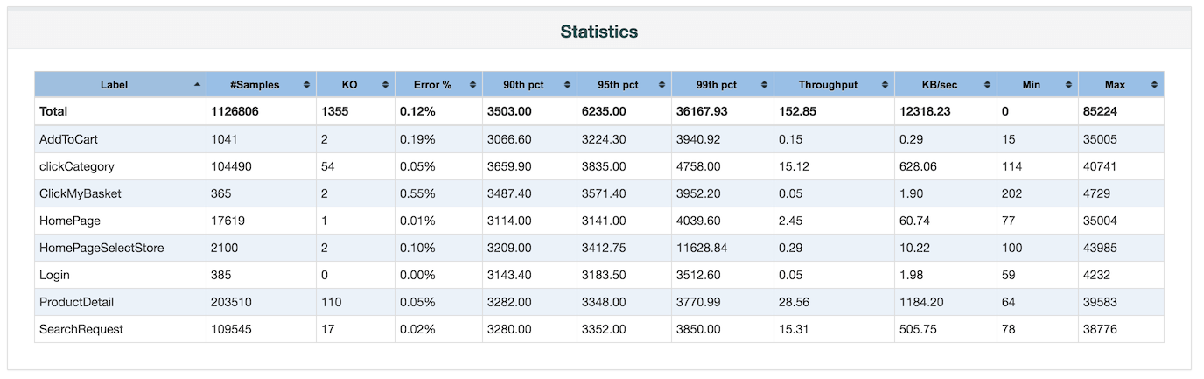
Report

Slide 8
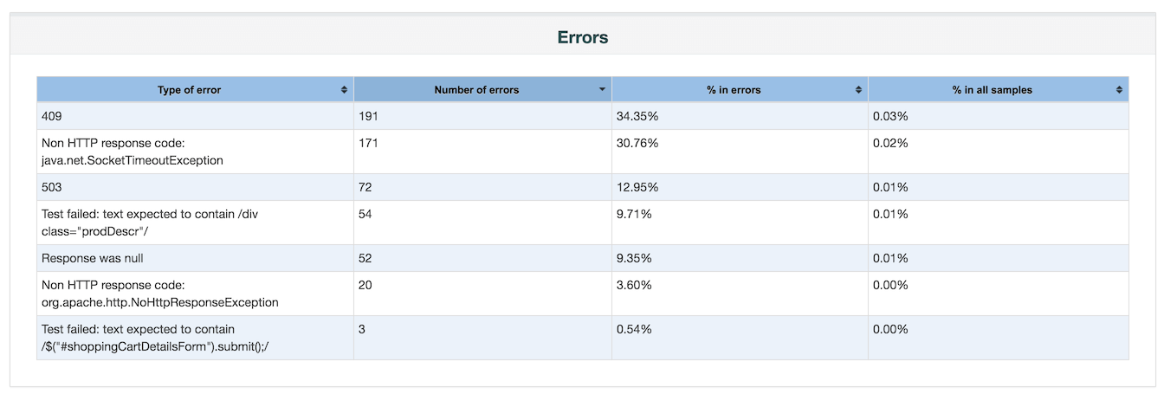
Report

Slide 9
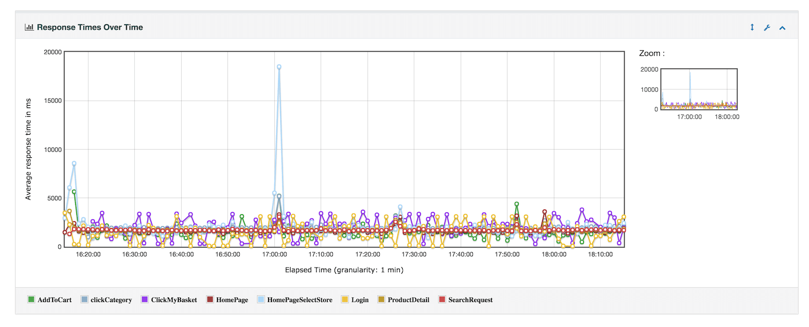
Report

Slide 10
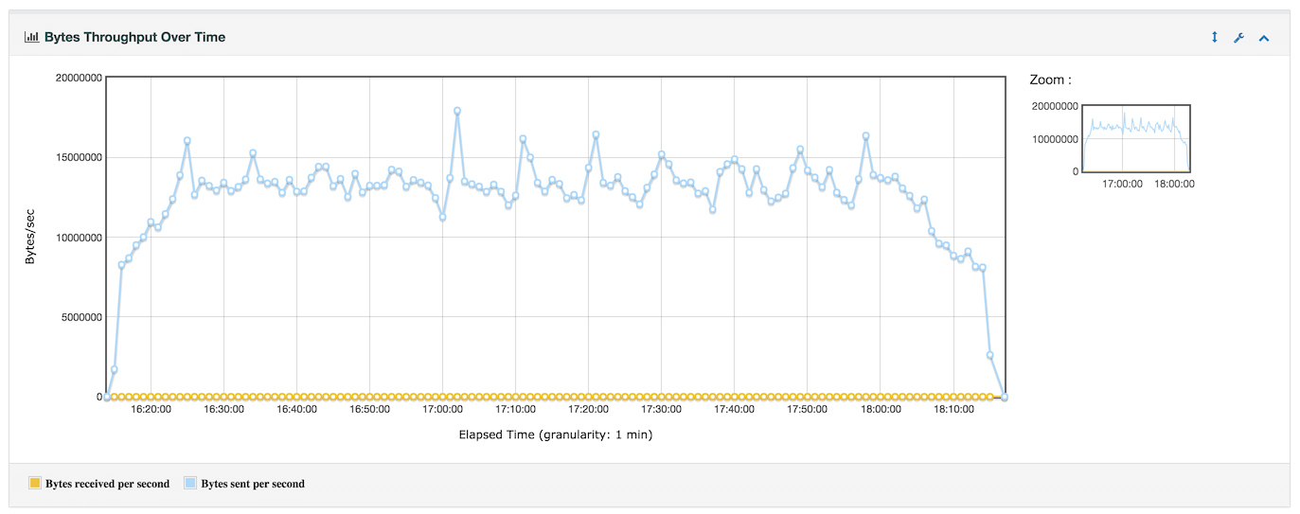
Report

Slide 11
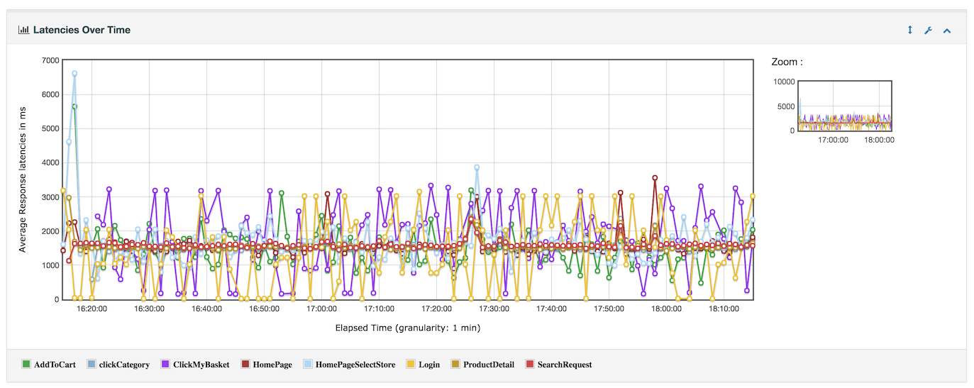
Report

Slide 12
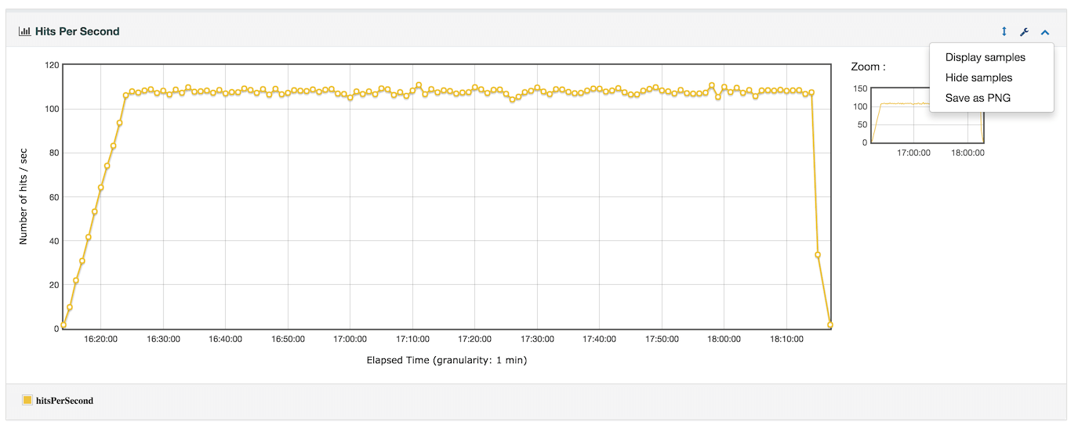
Report

Slide 13
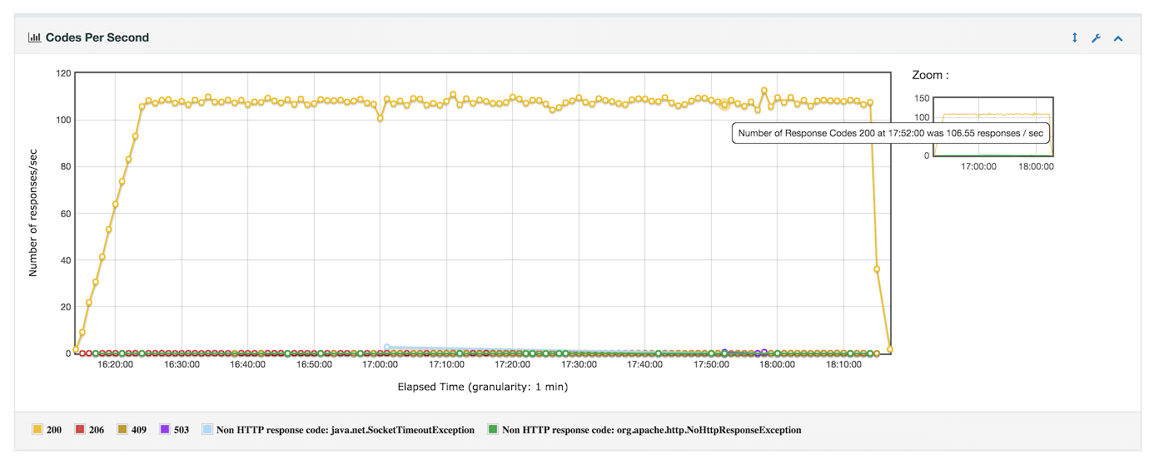
Report

Slide 14
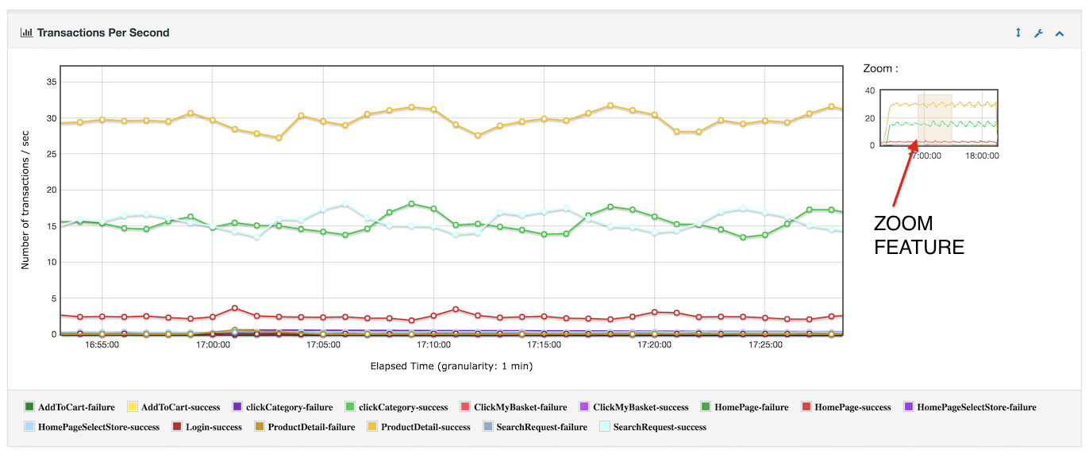
Report

Slide 15
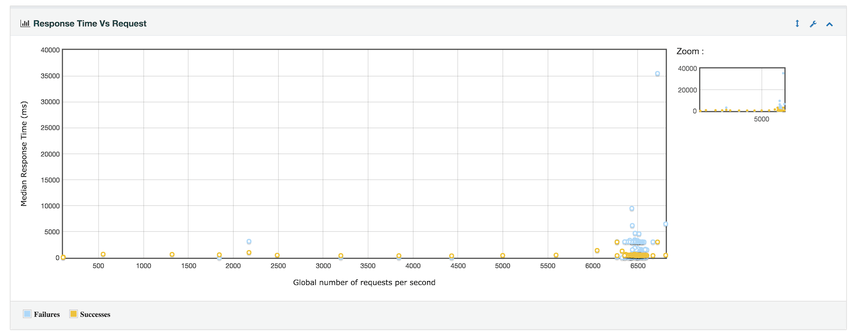
Report

Slide 16
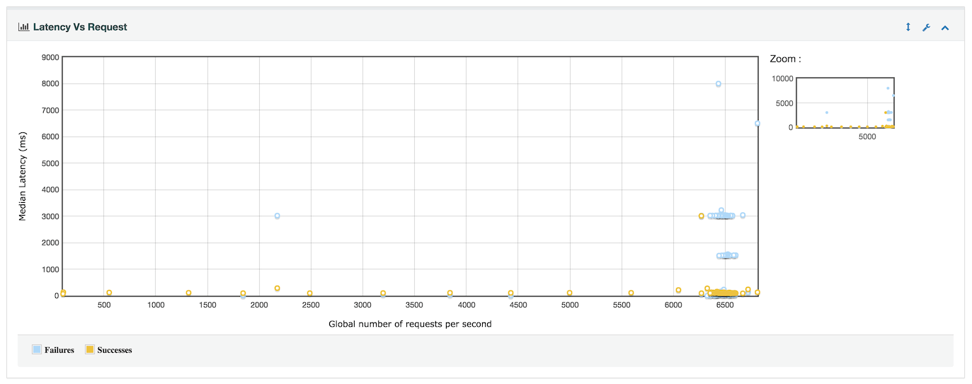
Report

Slide 17
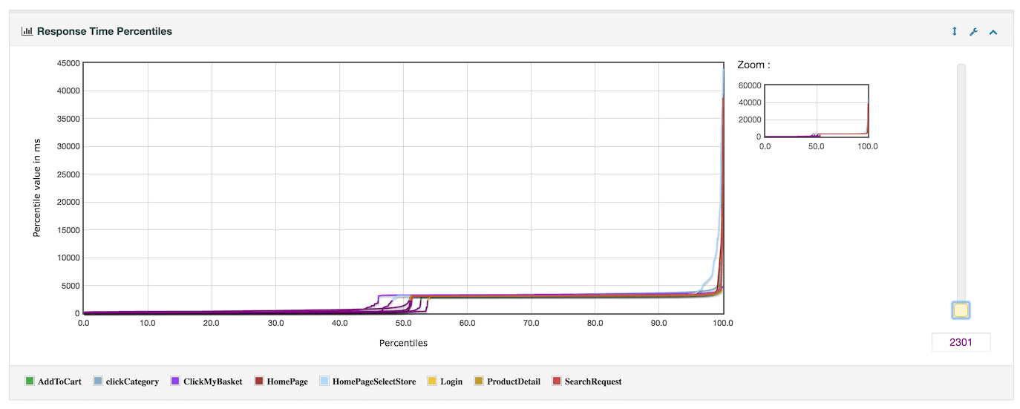
Report

Slide 18
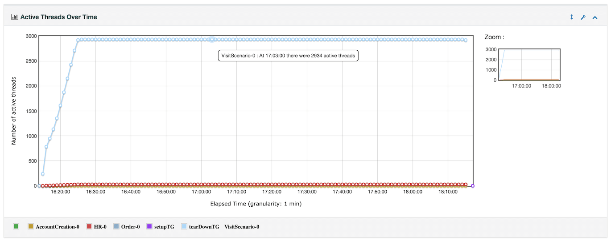
Report

Slide 19
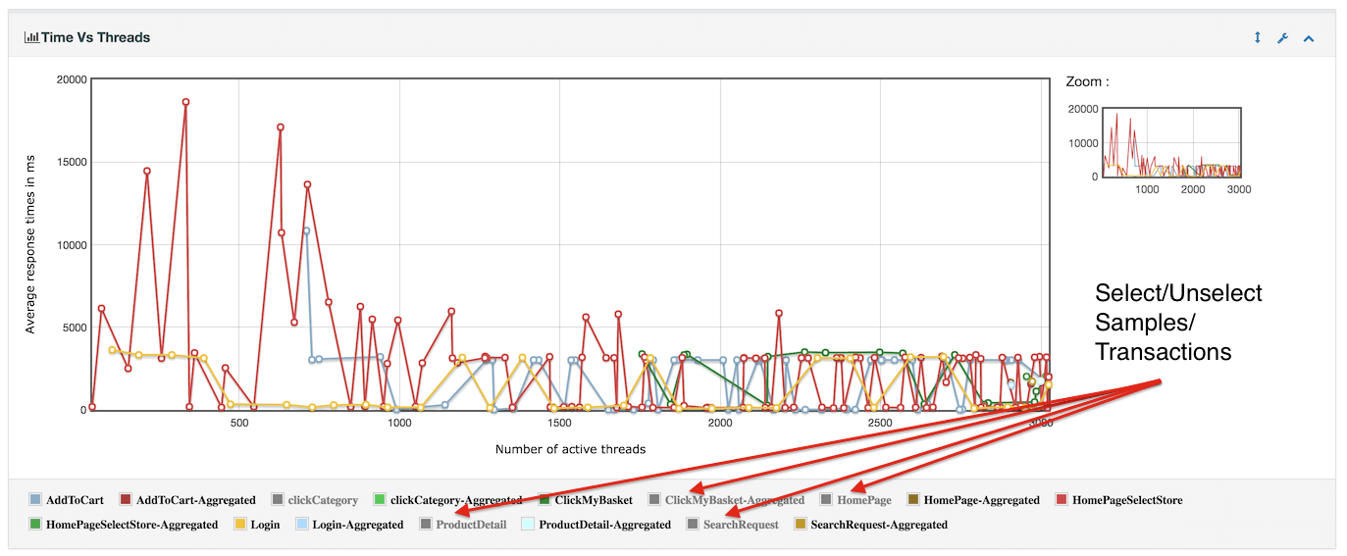
Report

Slide 20
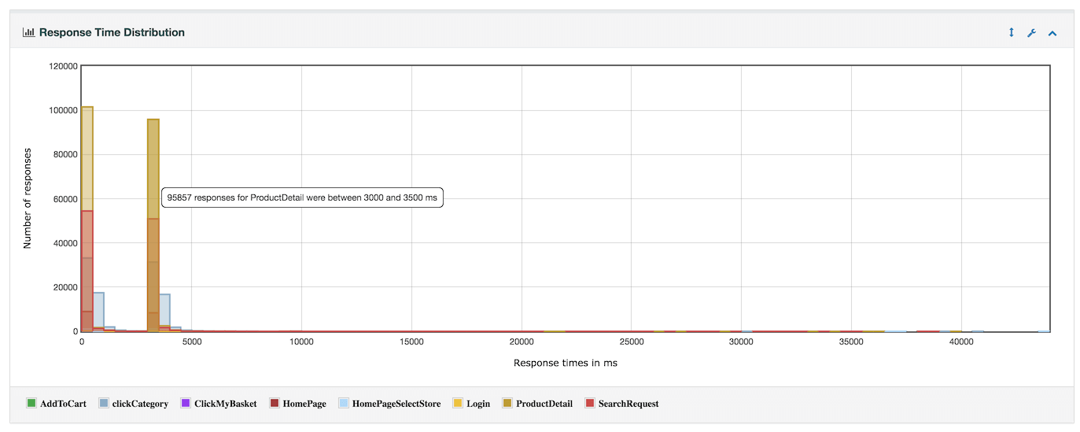
Report

Slide 21
Next steps
Prepare Report
Baseline the report
Compare with Benchmarks and previous results

Slide 22
Vocabulary
Throughput - # requests/second, pages/second, hits/second Correlation – get data which are unique for each run of the script
Parameterization – test with multiple set of data or records. A parameter replaces a literal value in the script.
Response time
Distributed testing
Ramp-Up – the amount of time to start all the threads
Duration – the amount of time to run the test continuously after ramp-up
Loop – the number of time to run the performance test.

Slide 23
Vocabulary
Number of Threads: Number of users to simulate
Ramp-up Period: To initialize the users on to server
Loop Count: Denotes the number of times the user to perform a particular test
Delay Thread creation until needed: Waits until the completion of the time mentioned to create threads
Scheduler :To enable or disable the scheduler
Start Time: Available only after enable of scheduler, used to mention at what point of time the execution need to be started
End Time :Available only after enable of scheduler, used to mention at what point of time the execution need to be stopped
Duration :Available only after enable of scheduler, used to mention how long the execution is to be happened.
Note: If duration time is mentioned, then the end time will be ignored
Startup delay :Available only after enable of scheduler, used to choose the startup delay

Slide 24
Dashboard

Slide 25
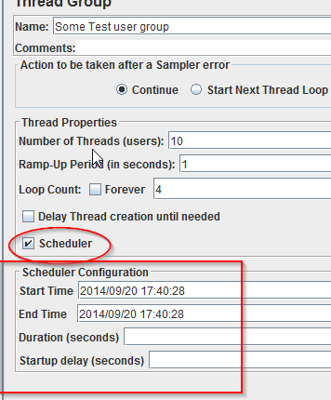
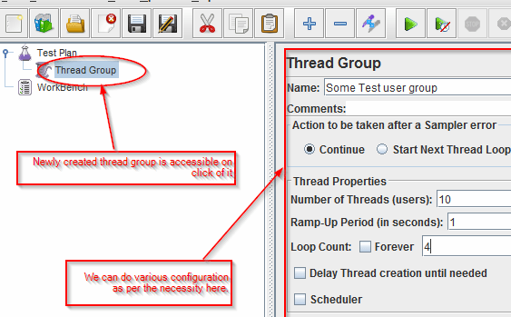
Configuration Requirements
Scheduler
Threads, Ram-up, Iteration

Slide 26
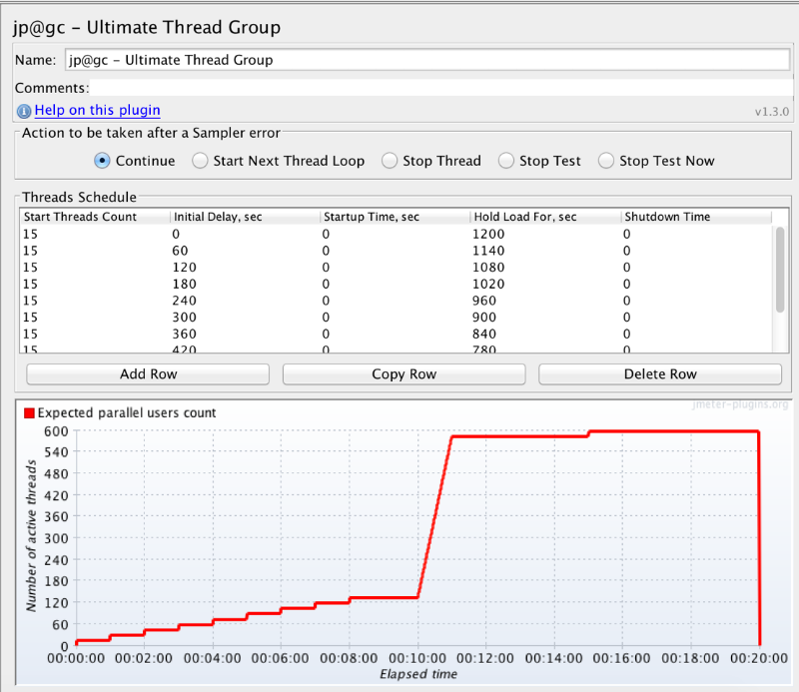
Configuration Requirements
More complex!

Slide 27
Configuration Requirements
Master
Remote hosts: IP, port
Slave
Server port
RMI port
Multi-geo Load Generator

